Slide 1

The evolution of herbicide resistance in agricultural weeds

Slide 2
Lecture outline
Origins of herbicides
First cases of herbicide resistance
Target site resistance
Non target site resistance
Irish weed research

Slide 3
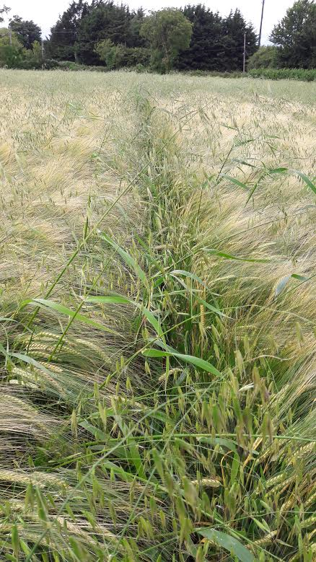
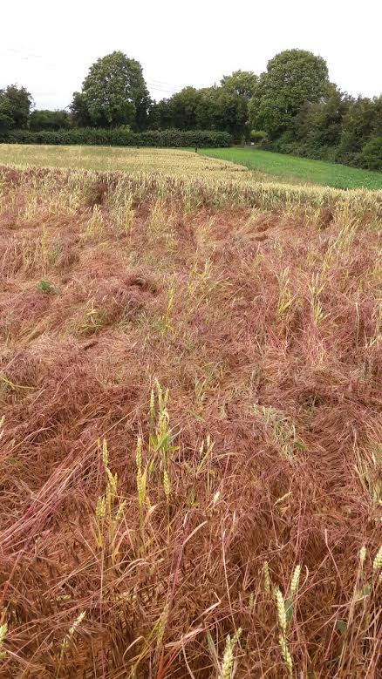
What is a weed?
Any plant growing where it is unwanted in competition with a cultivated species

Slide 4
Herbicides
A substance used to kill vegetation.
Two main types
  Selective herbicides kill specific plants (typically weeds) but do not kill others (typically the crop).
  Non-selective herbicides kill all vegetation they are applied to.

Slide 5
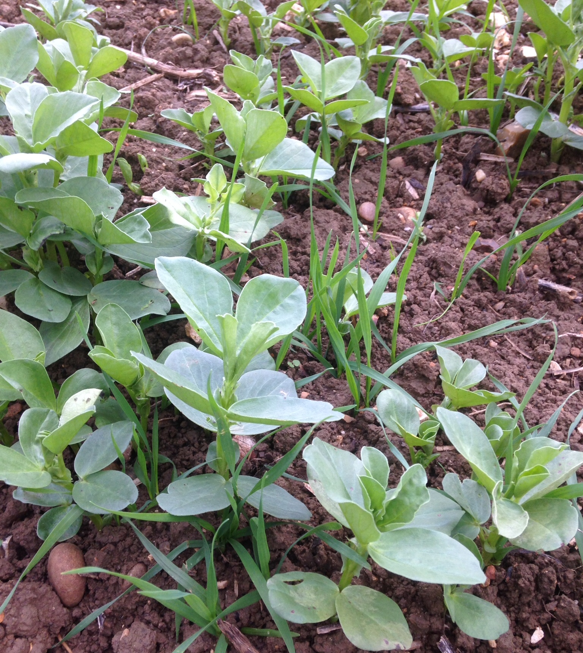
Selective herbicides: an example
Acetyl CoA carboxylase inhibitors (ACCase) inhibitors.
Prokaryotic and eukaryotic ACCase.
Eukaryotic ACCase is sensitive to ACCase inhibiting herbicides.
Plastidic and cytosolic ACCase.
Monocots have plastidic and cytosolic eukaryotic ACCase.
Dicots, on the other hand, have only cytosolic eukaryotic ACCase.
ACCase inhibiting herbicides target plastidic ACCase.
Thus, only monocots are killed, with dicots unaffected.
3 main families of ACCase inhibitors: “dims”, “fops” and “dens”

Slide 6
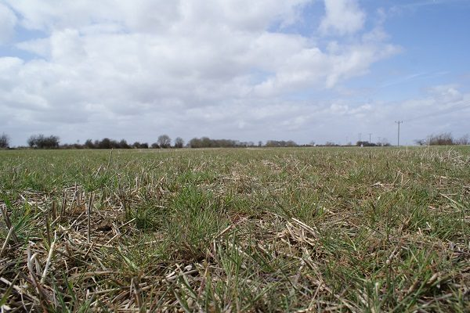
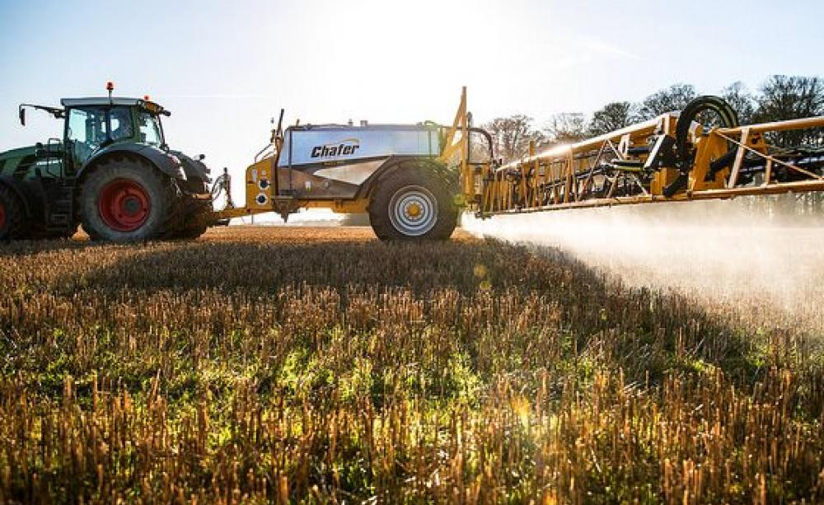
Non-selective herbicides: an example
5-enolpyruvylshikimate-3-phosphate synthase (EPSPS) inhibitors.
AKA Glyphosate
AKA Roundup
EPSPS is an important part of the shikimate pathway which produces many aromatic products such as lignins, alkaloids, flavonoids, benzoic acids, and plant hormones, in addition to amino acids needed for protein synthesis.
This makes glyphosate such a useful herbicide!
Save questions about how much I’m being paid by Monsanto for the end please.

Slide 7
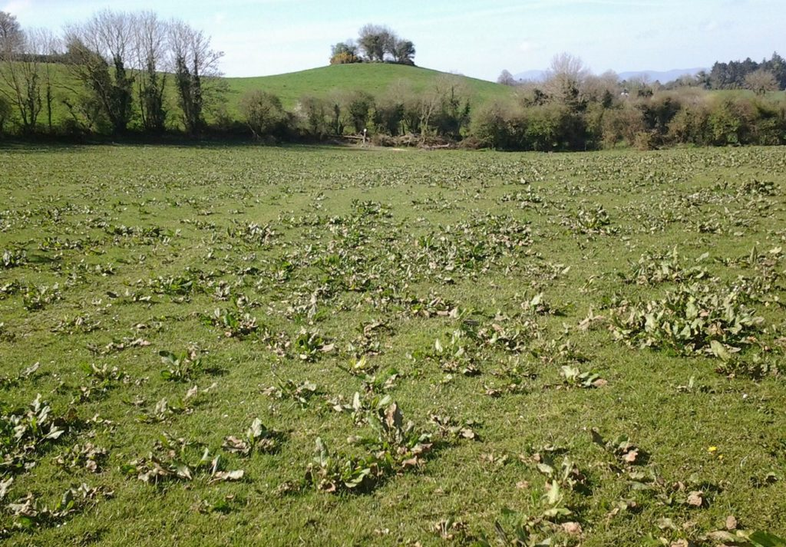
Early herbicide research
Commercial herbicides were developed during World War II.
2,4-D, the first herbicide came from research investigating the role of IAA in plant growth regulation.
Researchers found that high doses of IAA would kill dicots, however IAA was too unstable to be used effectively.
2,4-D is essentially a synthetic auxin.
Rapidly increased farm efficiency, effectively “replaced the hoe”
Kept secret because initial plans were to use herbicides to destroy German crops to help starve the war effort.
Never materialised, but tactic was eventually used by the US army during the Vietnam War, which was very sound of them.

Slide 8

Early herbicide research
Commercial herbicides were developed during World War II.
2,4-D, the first herbicide came from research investigating the role of IAA in plant growth regulation.
Researchers found that high doses of IAA would kill dicots, through uncontrollable cell division in meristematic zones. However IAA was too unstable to be used effectively.
2,4-D is essentially a synthetic auxin.
Rapidly increased farm efficiency, effectively “replaced the hoe”
Kept secret because initial plans were to use herbicides to destroy German crops to help starve the war effort.
Never materialised, but tactic was eventually used by the US army during the Vietnam War, which was very sound of them.

Slide 9
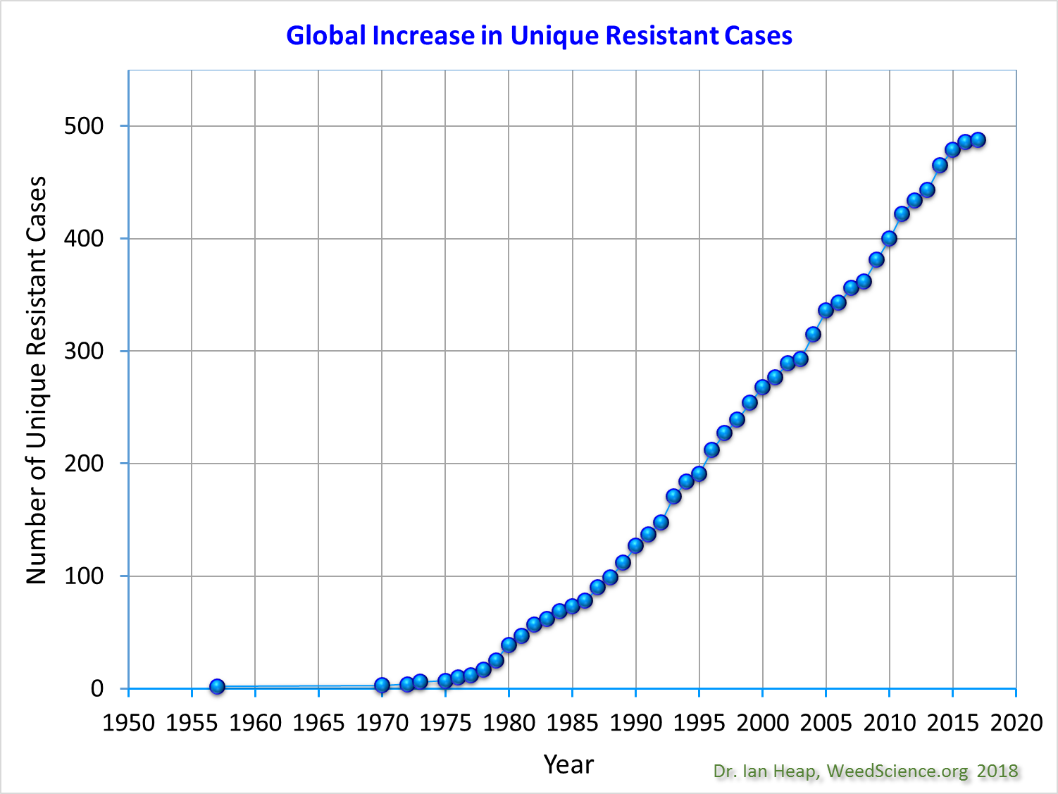
Global herbicide resistance
First cases of herbicide resistance were reported in the US in the 50s, shortly after the introduction of commercial herbicides.
Resistance has been increasing steadily since
Resistance events were typically met with chemical solutions ie. new herbicide modes of action, But no new MOAs have been released in over 20 years

Slide 10
Global herbicide resistance
Why was Ireland so late to resistance?

Slide 11
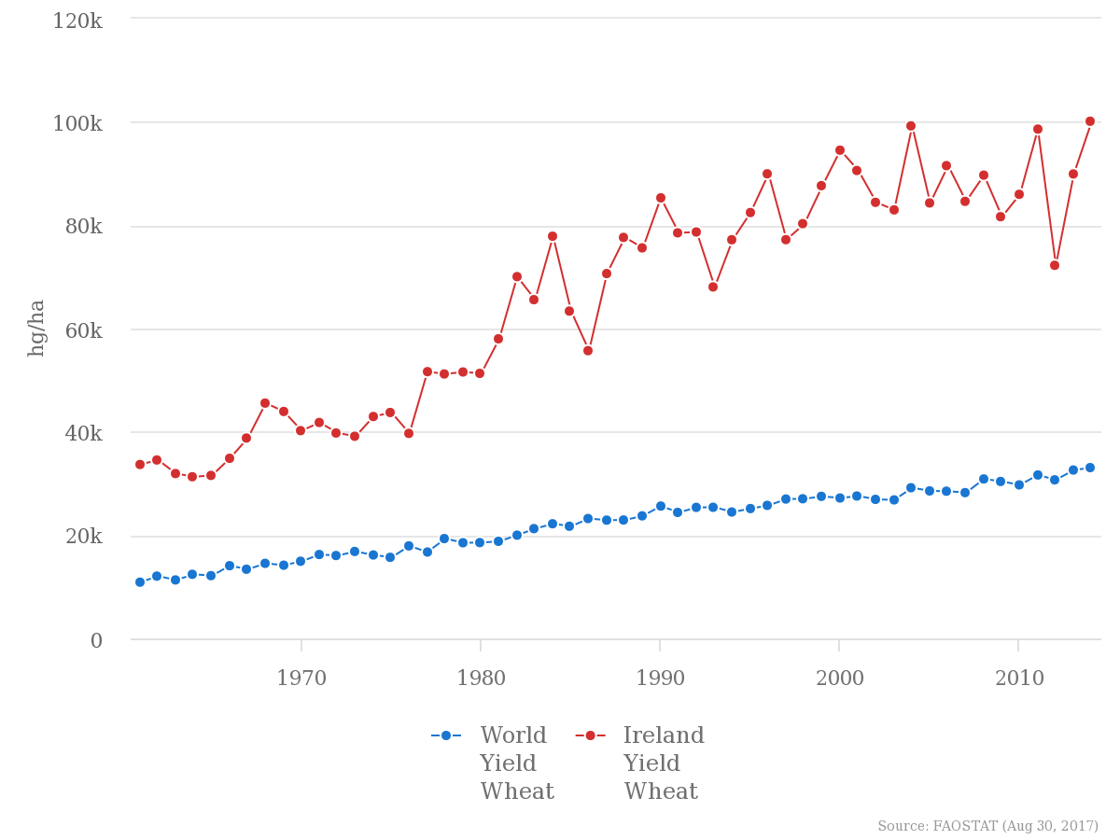
Global herbicide resistance
Why was Ireland so late to resistance?
Ireland has one of the best climates in the world to produce cereals in.
We have very vigorous, competitive crops resulting in these high yields

Slide 12
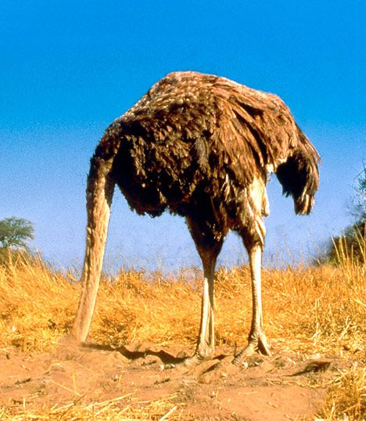
Global herbicide resistance
Why was Ireland so late to resistance?
It’s also entirely likely that herbicide resistance has been an issue under the surface in Ireland for a number of years

Slide 13
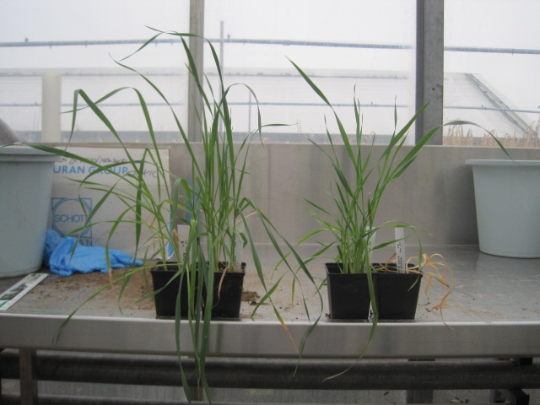
Herbicide resistance in Ireland
Long suspected but only confirmed for the first time in 2016.
Species:
  Wild oats (ACCase + ALS)
  Sterile brome (ALS)
  Great brome (ALS)
  Black grass (ACCase + ALS)
Suspected species:
  Annual meadowgrass
  Italian ryegrass

Slide 14
Proximal versus distal causes
Proximal causes are events that are the closest to, or immediately cause the observed effect.
Distal causes are thought of as the ultimate reason the observed effect happened, only chronologically further from said event.
Why do we care?

Slide 15

Proximal versus distal causes: an example
The Golden State Warriors won the 2018 NBA championships.
The proximal cause of this event was GSW winning game 4 of the finals vs Cleveland, 108-85

Slide 16

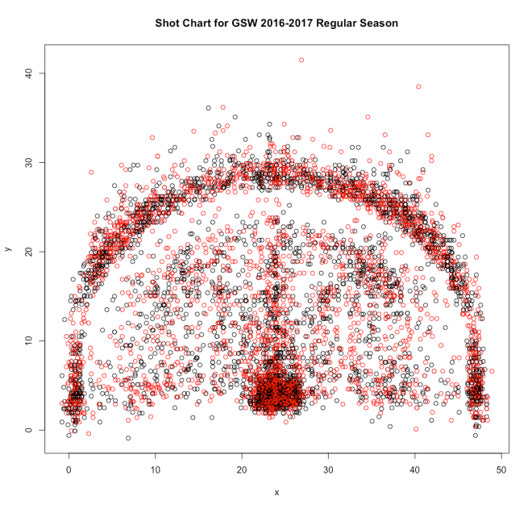
Distal causes of GSW winning the 2018 NBA championships.
The NBA salary cap spiked in the summer of 2016, facilitating GSW to sign Kevin Durant.
The early portion of Stephen Curry’s career was plagued with ankle injuries, meaning the team was able to sign him on a contract for less than what he was worth.
A combination of rule changes during the 2000s and advancements in the statistical analysis of basketball lead to three point shooting and floor spacing being of the utmost importance in the modern game.

Slide 17
Proximal causes of herbicide resistance
Target site point mutations.
Non target site resistance.
More on these later!

Slide 18
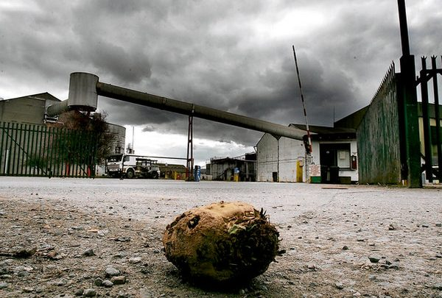
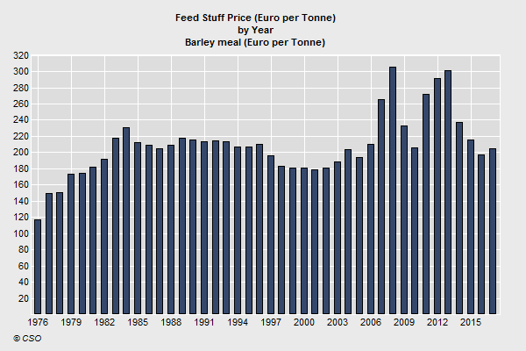
Distal causes of herbicide resistance.
Lack of crop diversity.
Narrow range of herbicide active ingredients.
Poor grain prices.
Lack of knowledge (weed identification).
Over-reliance on commercial agronomists.
The list goes on!

Slide 19
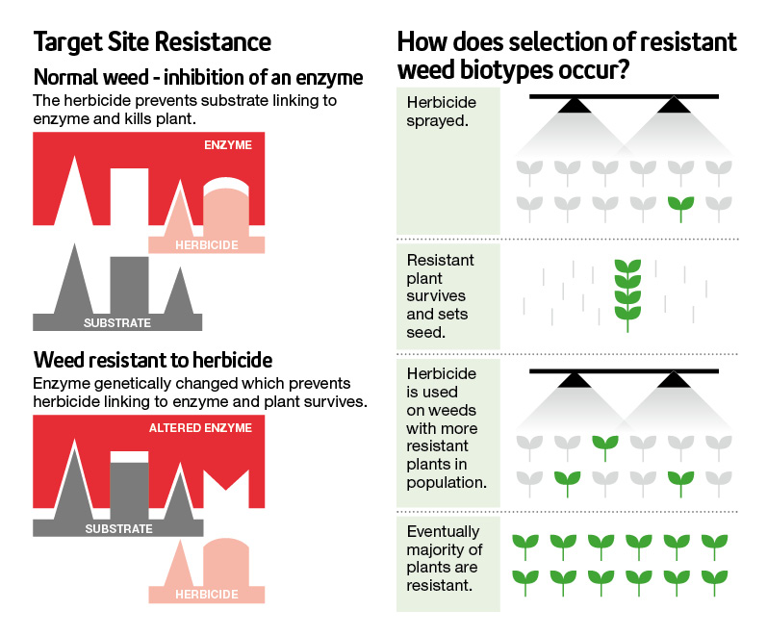
A basic model for target site resistance
A point mutation, typically in part of the gene that codes for the binding site of the herbicide.
Stops the herbicide from binding.
Doesn’t affect the normal function of the protein.
Plant can reproduce post-spray application.
Resistance allele becomes more frequent in population.

Slide 20
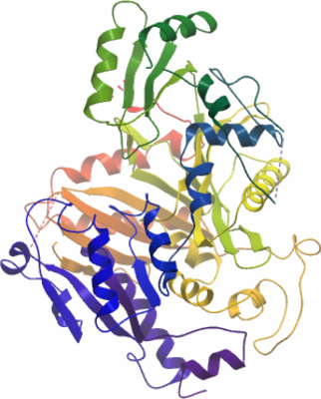
Target site resistance: ACC1
I1781L point mutation
Acetyl CoA carboxylase ACCase is required in plants for fatty acid synthesis.
Under normal circumstances, carboxylated biotin translocates to the carboxylase transferase CT active site.
Here, the carboxylase group is transferred to the acetyl CoA substrate.
This leads to the formation of malonyl CoA.
ACCase inhibiting herbicides bind to this CT domain, stopping this transfer.

Slide 21
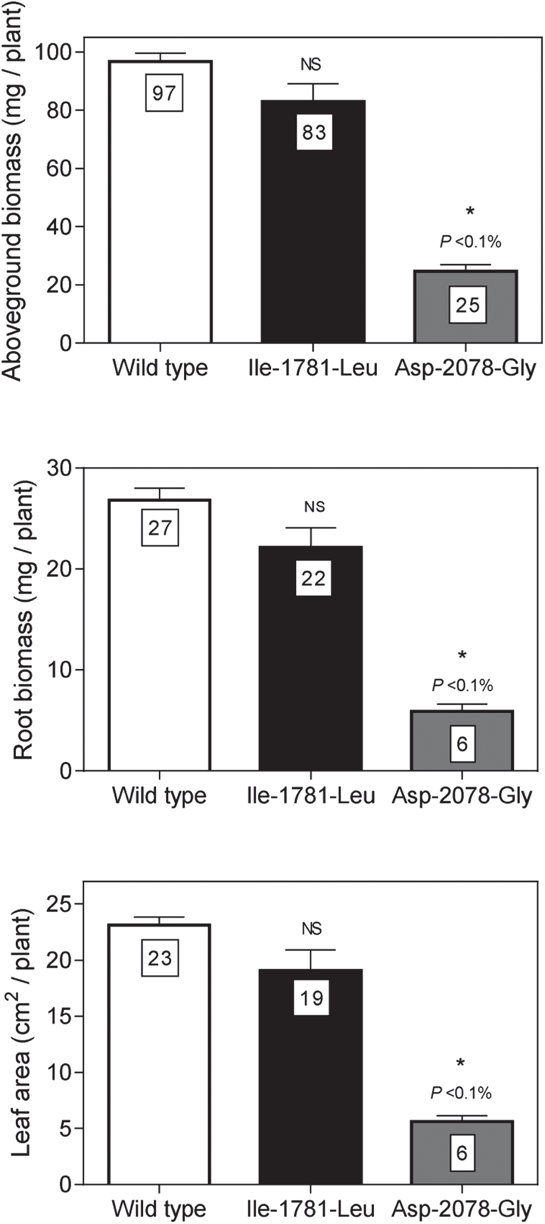
Target site resistance: ACC1
I1781L point mutation
The isoleucine 1781 residue is an important part of this binding point.
The I – 1781 – L substitution changes the conformation of the ACCase protein such that ACCase herbicides can no longer bind, but the protein can still bind to its substrate.
This point mutation occurs in an area of the CT domain involved in the binding of the three families of ACCase inhibitors.
Can cause cross-resistance to all three!

Slide 22
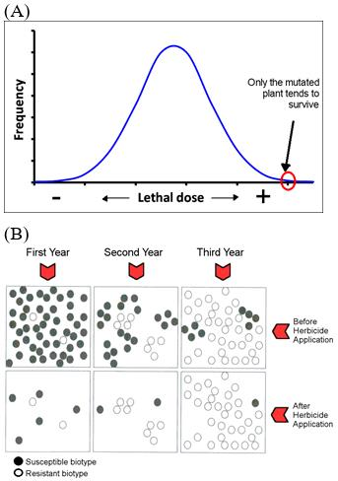
Non target site resistance
Plants within populations vary with respect to their resistance to herbicides based on standing genetic variation.
Consider herbicide application as a form of abiotic stress.
Consistent herbicide application selects for alleles that contribute to resistance, no matter how small the contribution to overall resistance.
This leads to an accumulation of minor resistance-endowing alleles

Slide 23
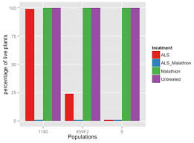
Non target site resistance
Cytochrome P450 monooxygenases are a major gene superfamily involved in abiotic stress tolerance.
Increased CYP450 activity allows plants an increased ability to metabolise herbicides.
This can confer broad spectrum resistance to a range of herbicides, even to active ingredients that haven’t been developed yet!
One way CYPs can be implicated in resistance is to inhibit their function and look at the effects on resistance

Slide 24
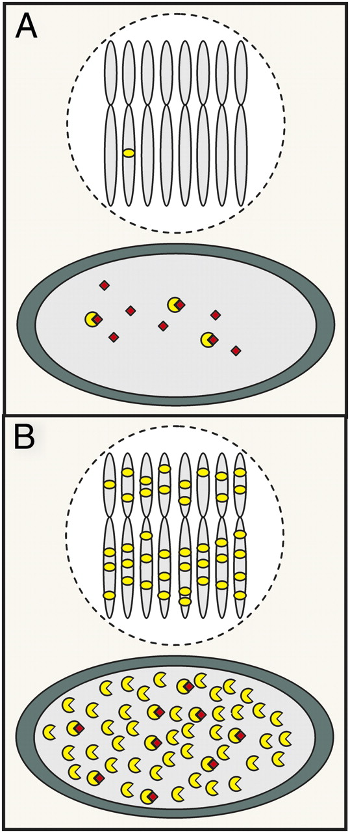
Resistance by increased gene expression
In wild type plants (A) normal doses of glyphosate are sufficient to inhibit EPSPS and kill treated plants.
Resistant plants (B) produce sufficient EPSPS to continue to operate the shikimate pathway despite application of glyphosate.
This can be achieved through increased EPSPS copy number, or increased gene expression.
Glyphosate, and all herbicides can only be applied legally at certain doses.
Furthermore, herbicides have an economic threshold!

Slide 25
Irish herbicide resistance research
ACCase cross resistance in Irish wild oats.
Distribution and frequency of resistance in Co. Wexford.
Effect of gibberellins on seed dormancy and herbicide resistance.
ECT – Enable Conservation Tillage

Slide 26
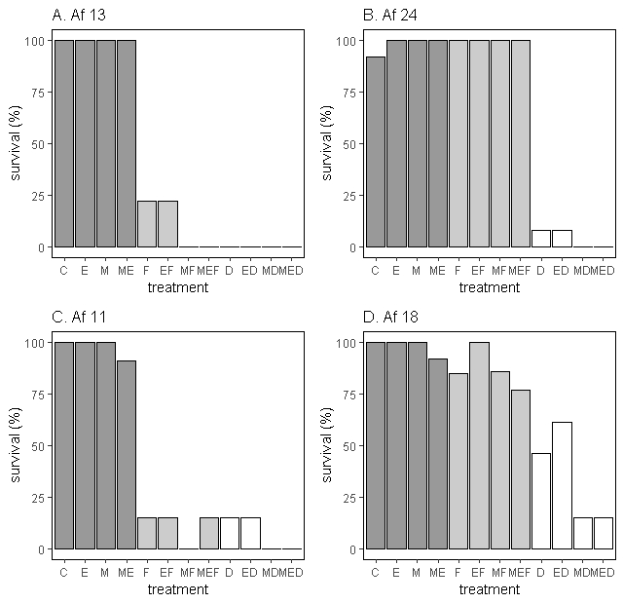
Cross resistance in Irish wild oats
Three objectives:
  Determine levels of resistance to propaquizafop and pinoxaden in 4 populations of wild oats.
  Inhibit CYP450 and GST to understand their involvement in resistance.
  Sequence ACC1 to relate resistance phenotype to the presence of point mutations in the ACCase CT domain.

Slide 27
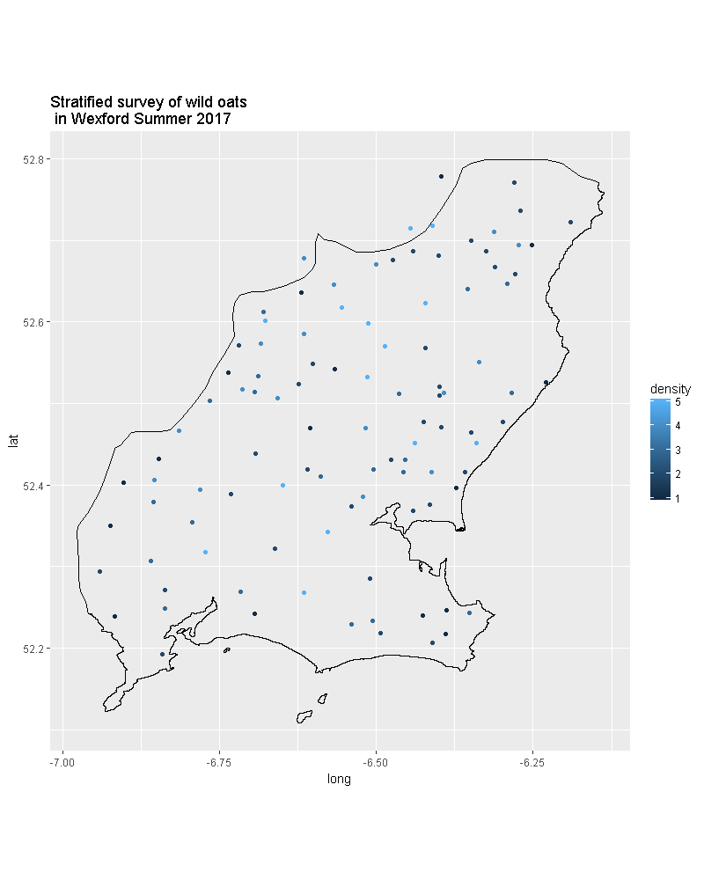
The distribution and frequency of resistance in Co. Wexford
Wexford has the largest area of crops grown of any county in Ireland.
Spring barley is a major crop in the area.
Spring germinating weeds are an issue.
ACCase resistant wild oats are becoming more prevalent.
But how prevalent? And why?

Slide 28
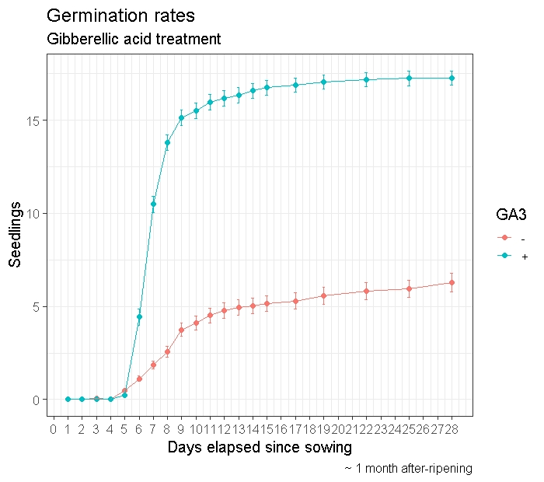
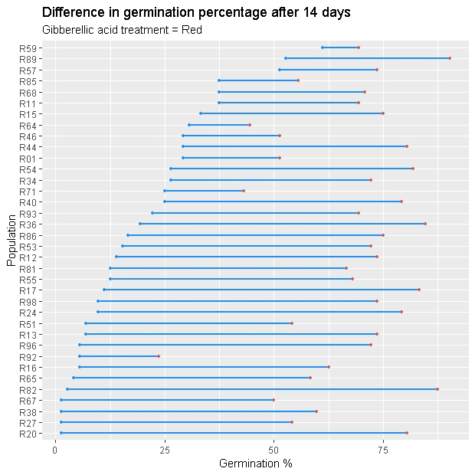
Effect of gibberellins on dormancy/ resistance.
Imbibing seeds with GA3 increases germination rate and germination percentage.
Populations differ in terms of dormancy as well their response to GA3. Dormancy is a complex, multifactorial trait.

Slide 29

Future directions?

Slide 30
Future directions
Any future interventions will have to mindful of eco-evolutionary implications of their implementation.
  Integrated weed management
  HWSC
From research side:
  NTSR
  How does resistance spread?
  What other life traits are associated with herbicide resistance and can they be utilised in a weed management strategy?

Slide 31
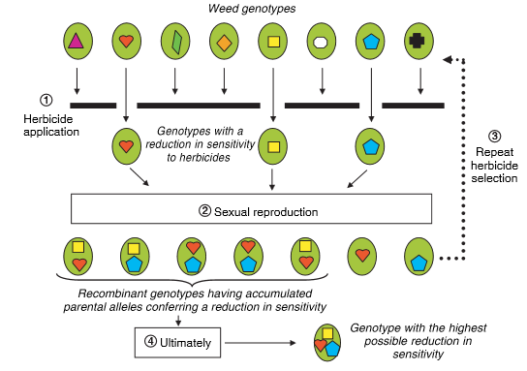
Probably not future directions tbh
More herbicides
We have already selected for weeds with decreased sensitivity to herbicides for the last 50+ years. If we address this problem solely with herbicides, evolution will win

Slide 32
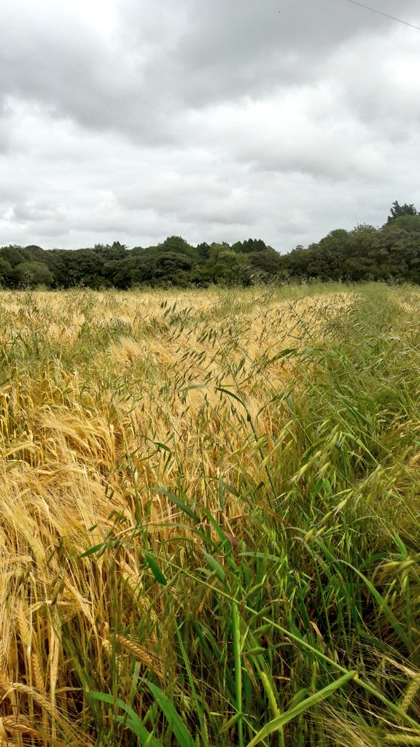
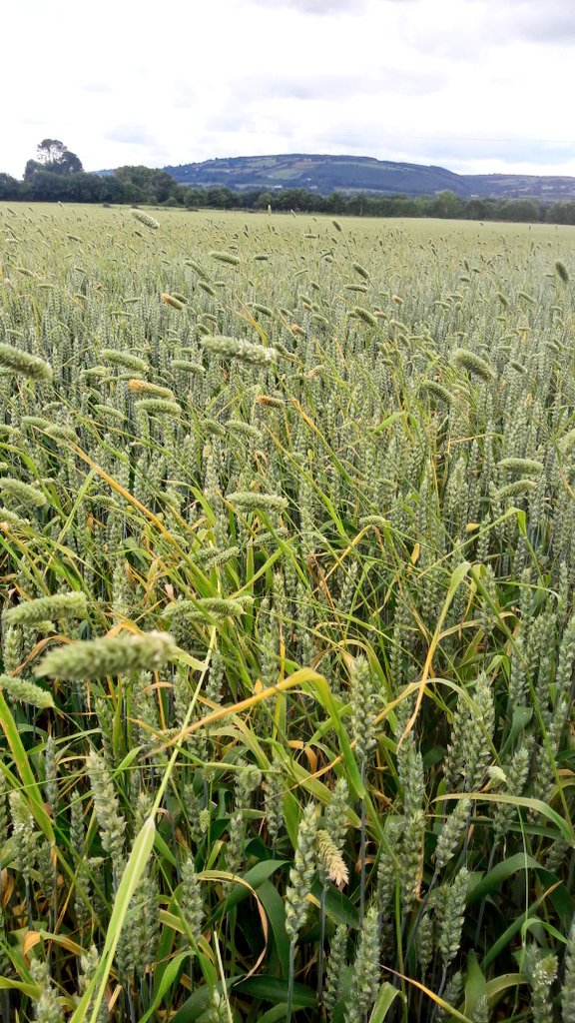
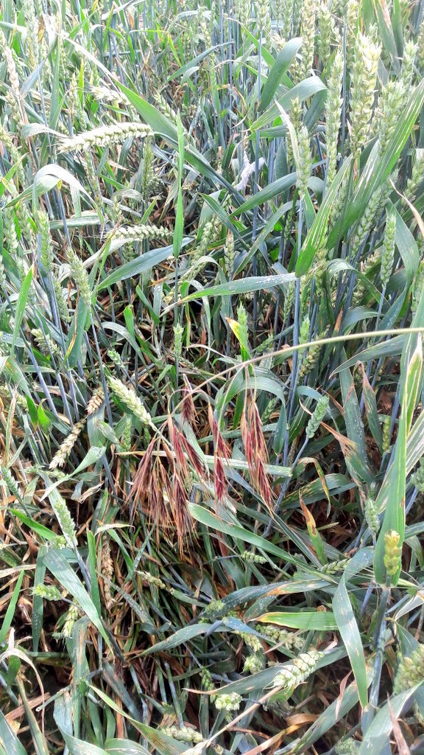
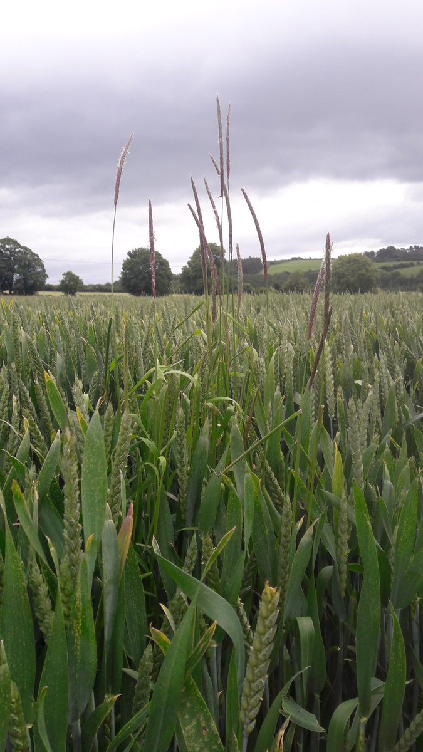

Cheers!
Research funded through the Teagasc Walsh Fellowship fund and the Irish seed trade association.

