Slide 1
Endophytes: a multifunctional toolset for agricultural crops
Workshop on pest/weed control in agroecosystems
Trinity College Dublin 5th October 2018
Brian R. Murphy (Trevor R. Hodkinson)
Department of Botany
Trinity College Dublin

Slide 2
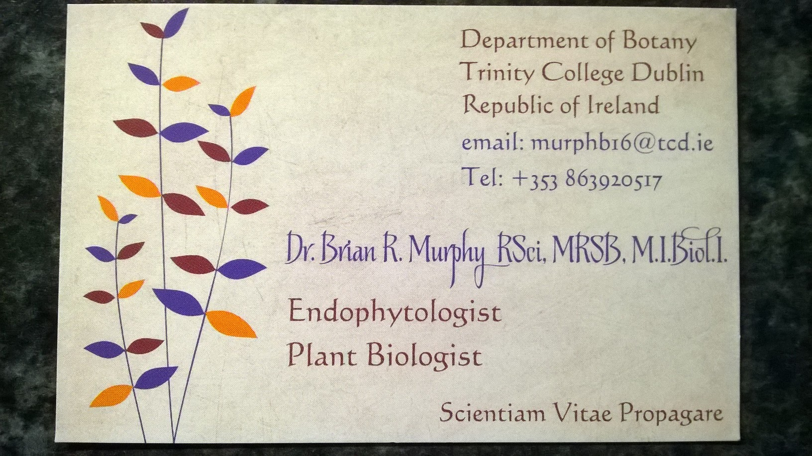
Endophyte?

Slide 3
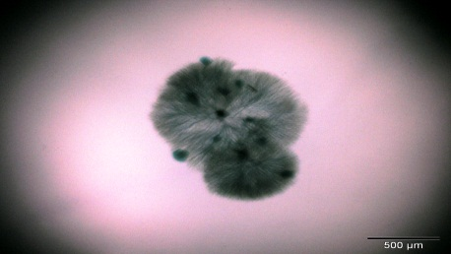
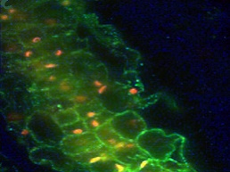
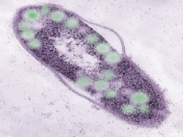
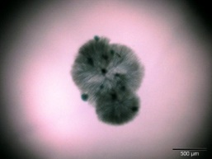
‘Endo’ + ‘phyte’ = ‘Inside’ + ‘plant’
Fungi
Bacteria
Unicellular eukaryotes
Fungi

Slide 4

Endophyte Diversity
Bacteria
Fungi
Pathogens
Mutualists
Microbiome
scicell.org

Slide 5
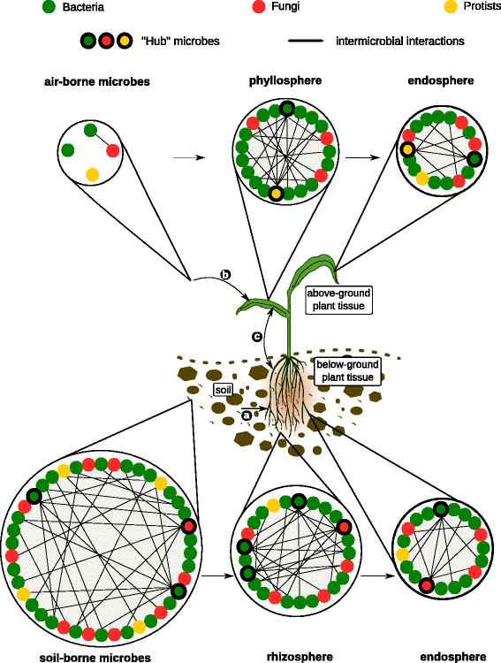
Complex Interactions
Representative microbial networks in different plant habitats. The figure illustrates microbial communities in the soil, air, rhizosphere, phyllosphere, and inside plant tissue (endosphere). In each of these habitats, microbes (represented by colored circles) could interact positively, negatively, or do not interact with other microbes (no lines).
From Hassani et al. 2018, Microbiome2018 6:58

Slide 6
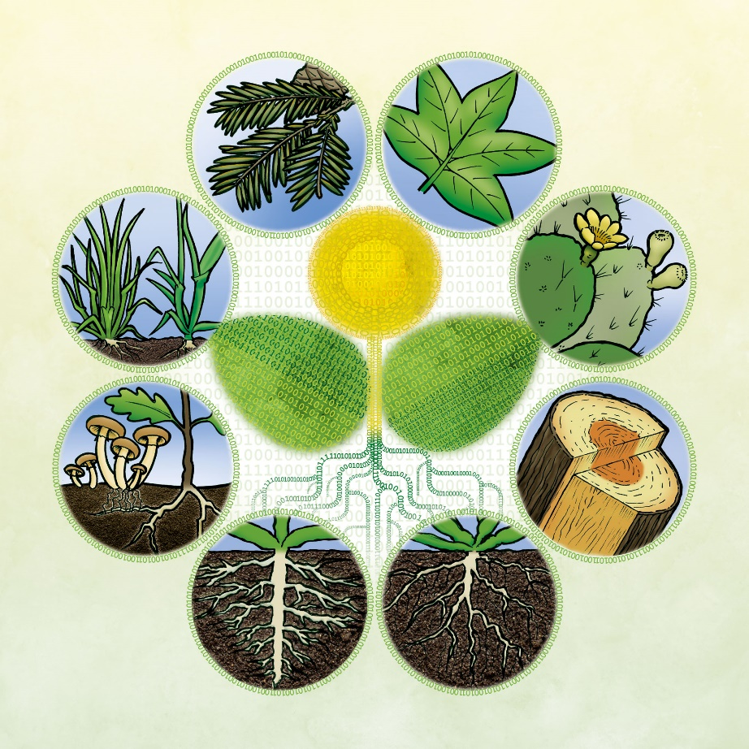
Modes of Action
Direct antagonism/competition
Plant stimulation
Antioxidant
Metabolites
Hormones
Gene regulation
Nutrient provision
newphytologist.org

Slide 7

Ecological Synergy
The extended genotype
The holobiont
Functional microbiome
Ecological engineers

Slide 8
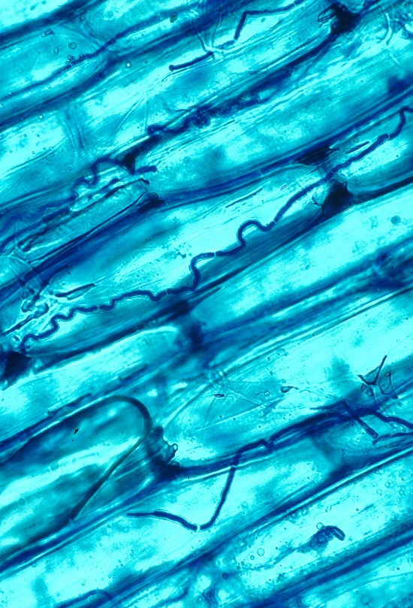
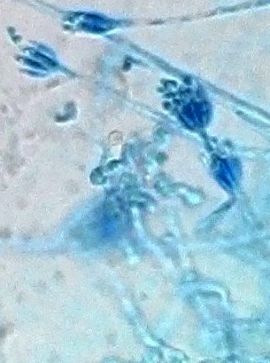
Endophyte groups
Endophyte ‘classes’
Clavicipitaceous
Non-clavicipitaceous
Dark septate endophytes
Obligate/facultative
Transmission modes
en.wikipedia.org
innovareacademics.in

Slide 9
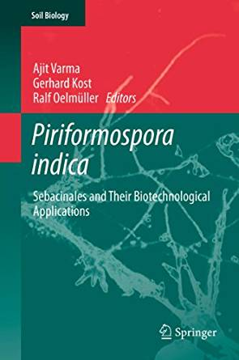
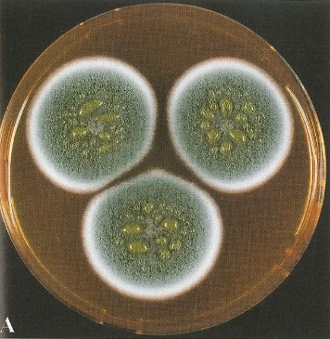
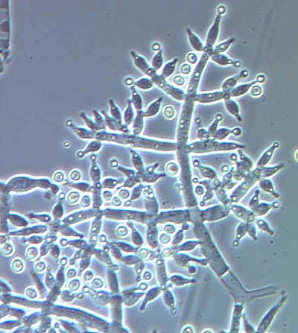
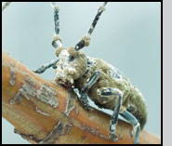
Star performers
Serendipita indica
Metarhizium sp.
Trichoderma sp.
Penicillium sp.

Slide 10
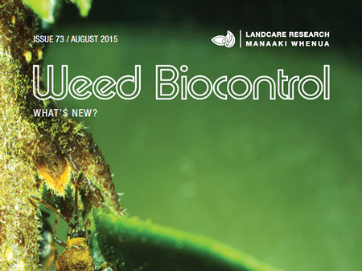
Context for pest/weed control
Weeds
Direct antagonism
Pathogens of weeds
Competition
Indirect effects

Slide 11
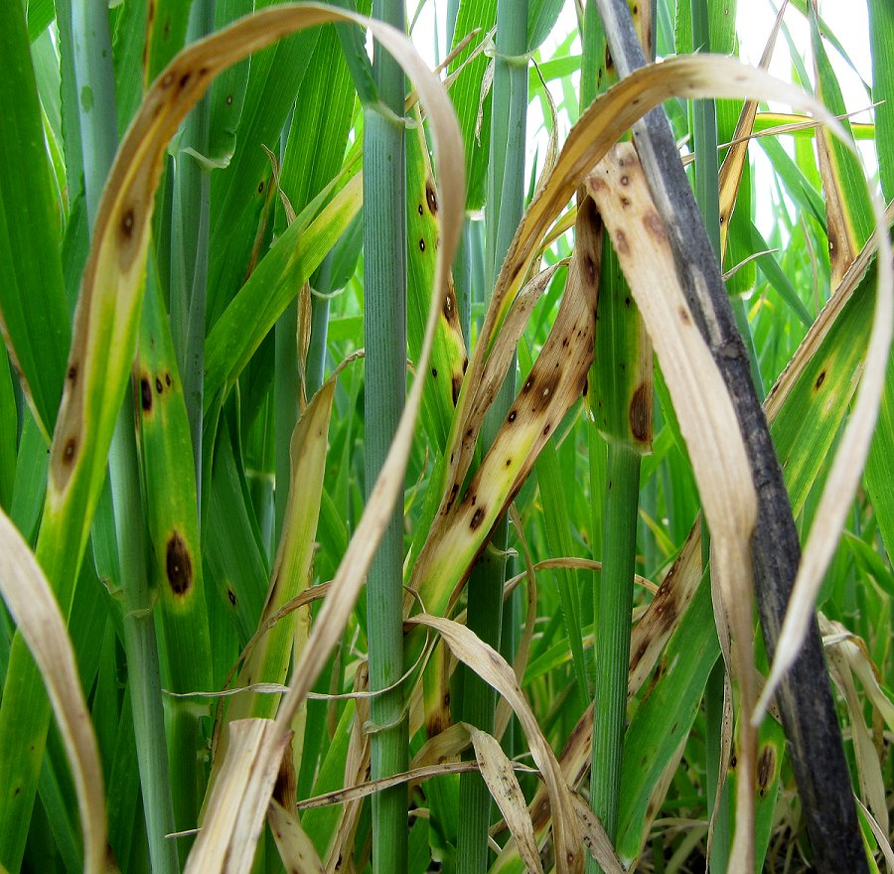
Biological control
Weeds
Insects
Bacteria
Fungi
Nematodes

Slide 12

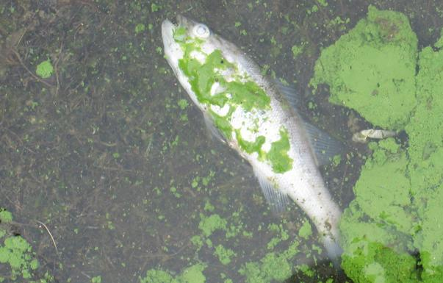
The Challenge we Address
Unsustainable use of synthetic chemicals
Economic costs
Environmental costs
Changing climate
http://modernfarmer.com/2013/07/agfunder-rob-leclerc/
http://www.ucsusa.org/our-work/food-agriculture/our-failing-food-system/industrial-agriculture

Slide 13
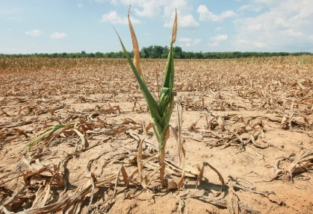
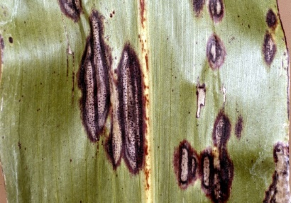
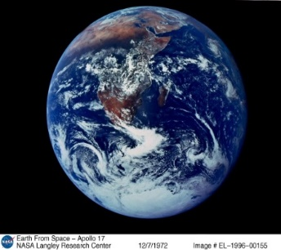
Endosyms benefit crops
Biotic stress
Abiotic stress
Image credits: iiaiblog.com, 12.000.scripts.mit.edu, www.hedgeco.net en.wikipedia.org
Yield increase
Environment
Global Climate Change
New Challenges

Slide 14
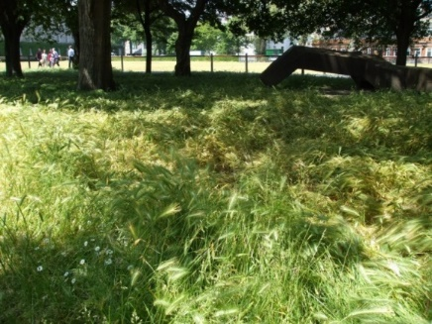
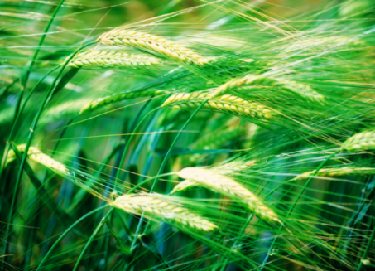
Endophyte research at TCD
Crop Wild Relatives
Wall barley
(Hordeum murinum)
Barley
(Hordeum vulgare cultivars)

Slide 15
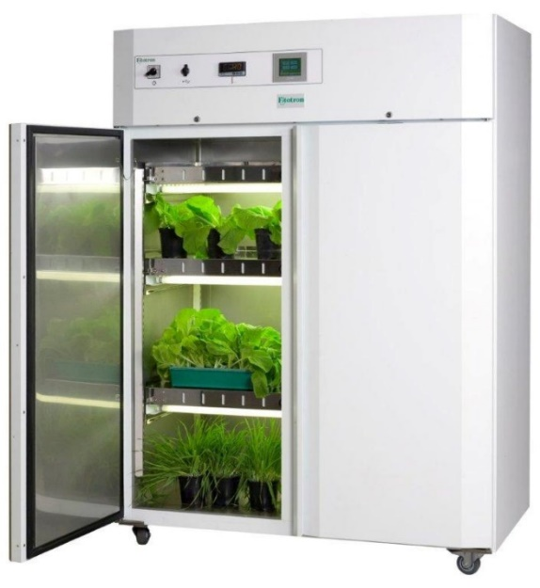
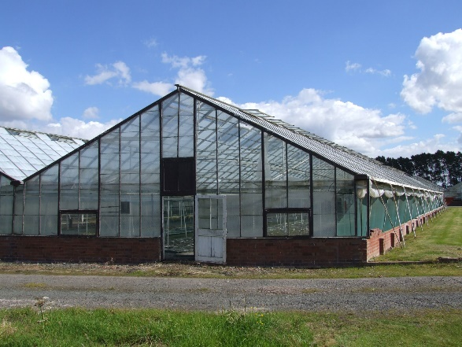
Endophyte research at TCD
Controlled environment
Biocontrol
Biofertilisation
Stress tolerance
Pot to Plot

Slide 16
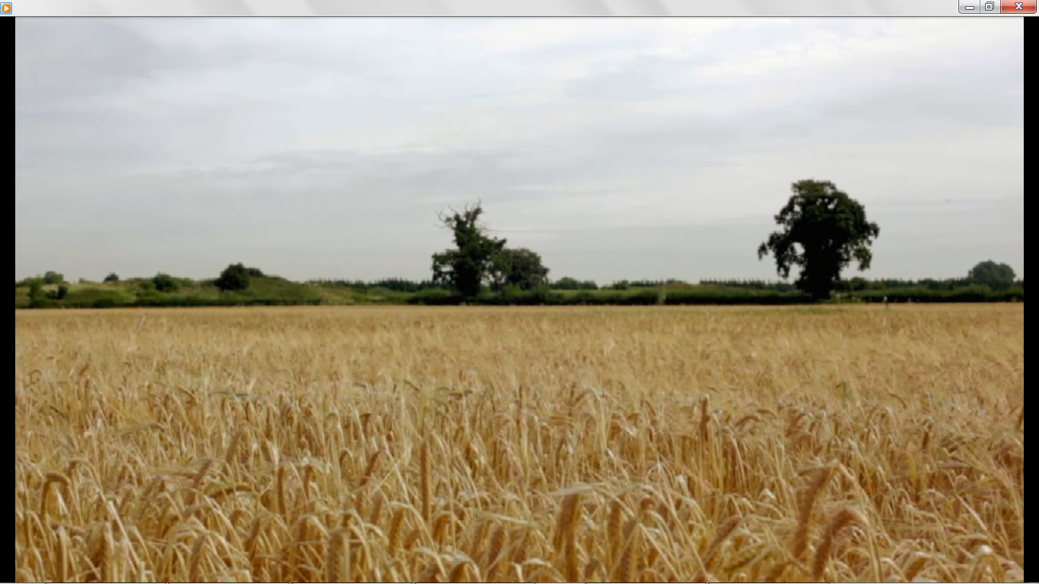
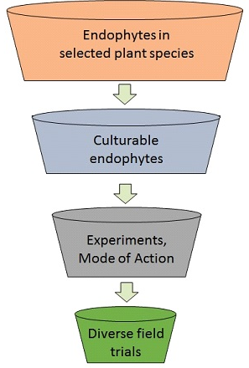
Selection and Field Trials
1000s
100s
Three barley cultivars
Three fertiliser levels
Three growing seasons
Three sites: Cork, Kildare
10s
10

Slide 17
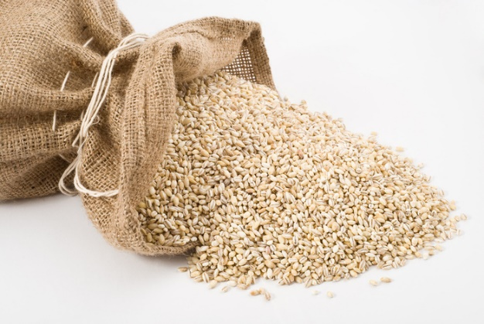


Greater yield increase with lower fertiliser input
Nitrogen input = 163 kg/ha 125 kg/ha
+ 1.3 t/ha
+ 0.5 t/ha
www.photo-dictionary.com
+ Endosyms
+ Endosyms
- Endosyms

Slide 18
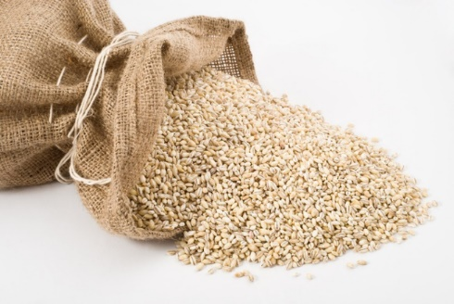
Endosym treatments restored yield
Full N input
50% N input
Full yield
- Endosyms
+ Endosyms

Slide 19
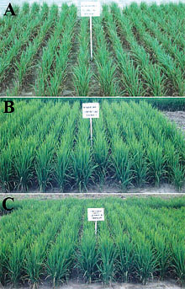
Fungicide tolerance
Growth stage 39:
750 g/l Fenpropimorph at 0.2 l/ha (Corbel®) and 250 g/l Prothioconazole at 0.4 l/ha (Proline®).
Growth stage 41:
41.6 g/l Epoxiconazole + 41.6 g/l Fluxapyroxad + 66.6 g/l Pyraclastrobin at 1.8 l/ha (Ceriaxl®) and 500 g/l Chlorothalonil at 1.0 l/ha (Bravo®).

Slide 20
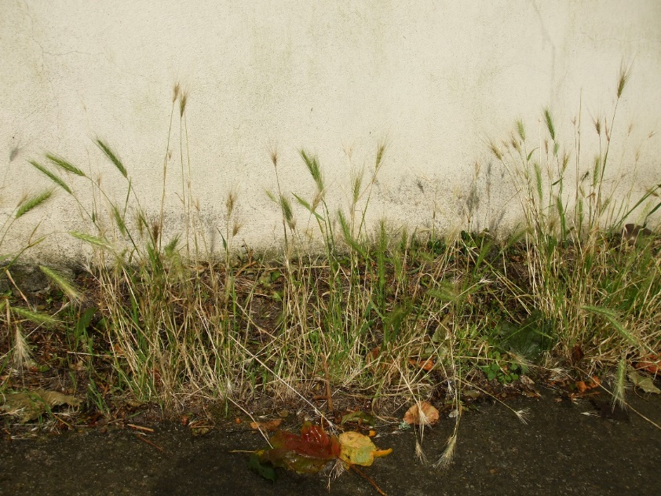
Endosym source sites
Low moisture
Low nutrients
Stressed plants
Barley relative

Slide 21
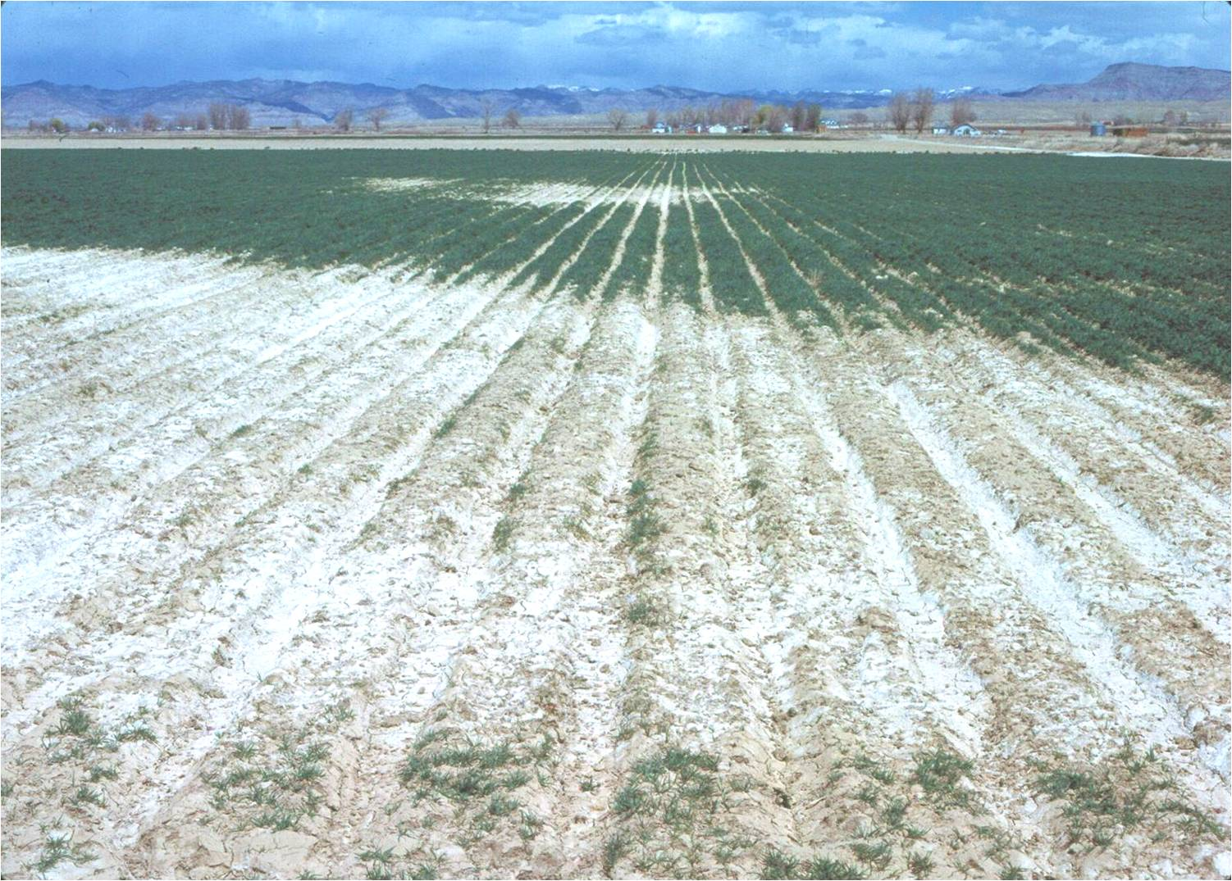
Endophyte research at TCD
Salinity stress
Endophyte-induced 39% increase in grain weight for salt-stressed plants
foodnavigator.com

Slide 22
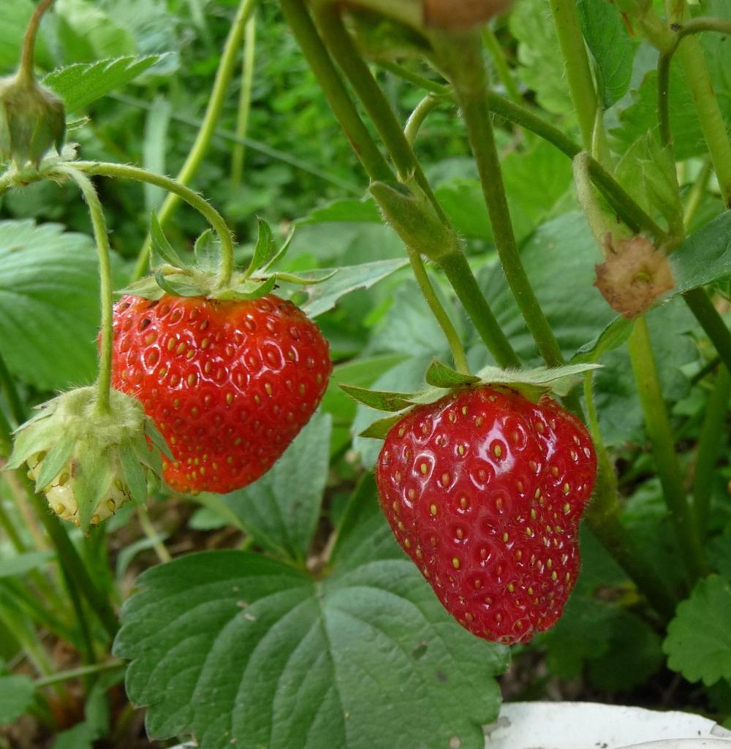
Endophyte research at TCD
Pathogen stress
49% more berries
51% greater weight
recipepes.com

Slide 23
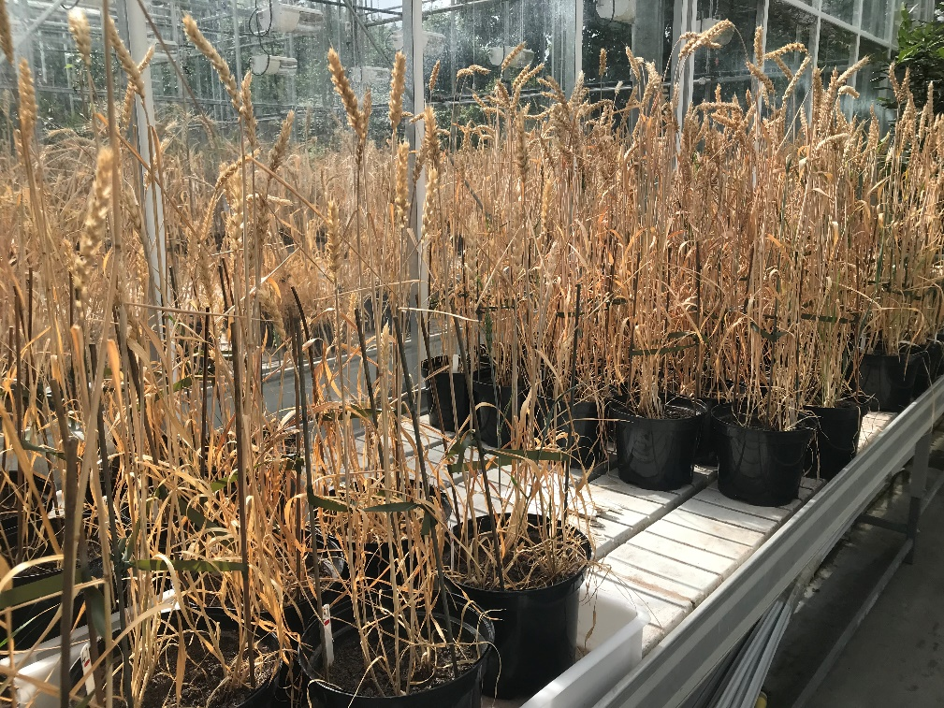
Endophyte research at TCD
Drought stress
14% more tillers
Increase in grain weight

Slide 24
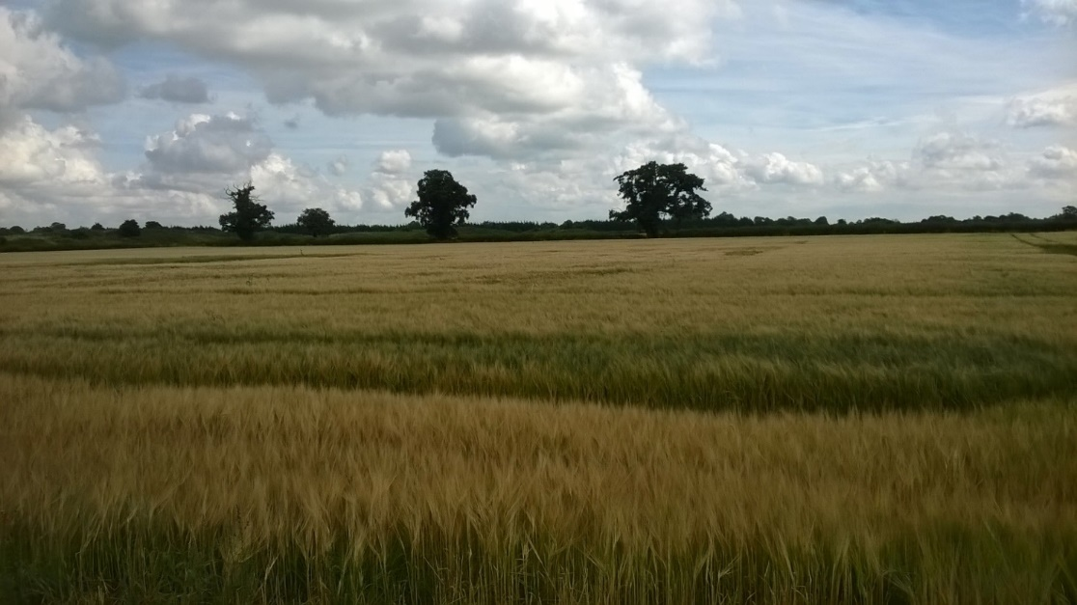
The Plant Microbiome
Ecological Restoration?

Slide 25
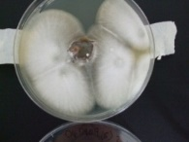
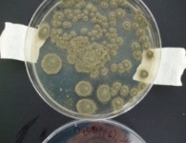
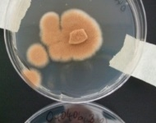
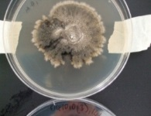
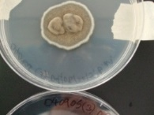
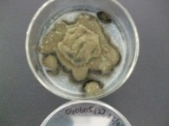
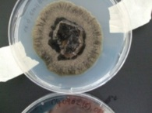
The Tip of the Iceberg?
One plant species
Ten populations
Fifty plants
One cereal crop
16 endosyms
Biocontrol
Biofertilisation
Barley, Wheat, Oat, and ?
>30 Publications

Slide 26
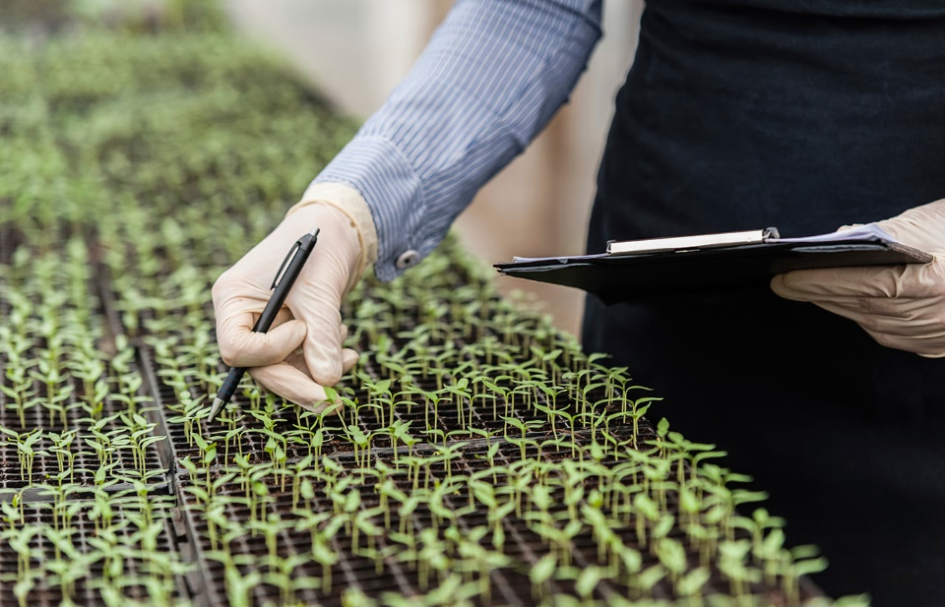
Planned research
Wheat, maize, rice, soy bean, oil seed rape.
Protected crops: Strawberry, lettuce, and tomato.
Synergy with other microorganisms.

Slide 27
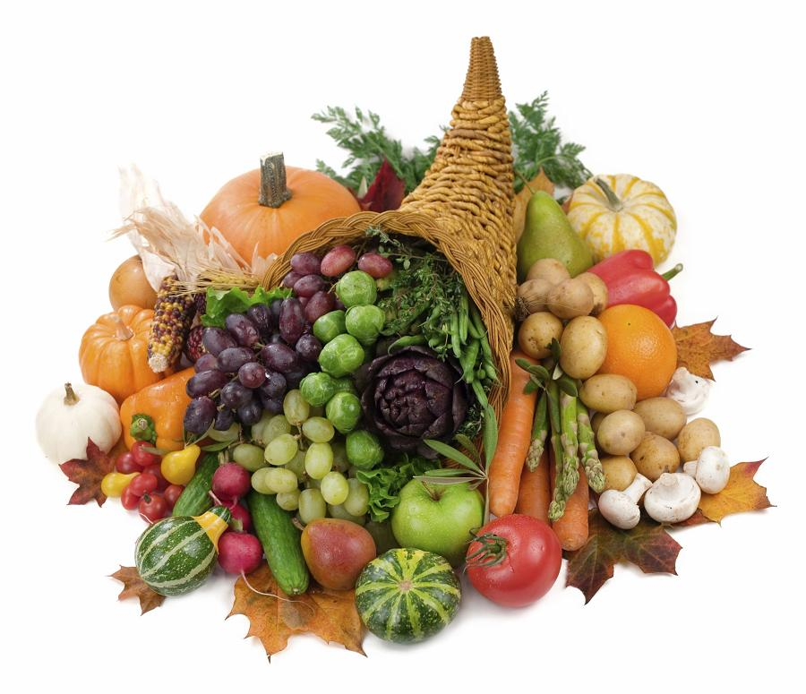
Potential for almost any crop
Crop wild relative
Controlled environment
Glasshouse
Field trials
Product
cornucopia â Living Wealthy Radio livingwealthyradio.com

Slide 28
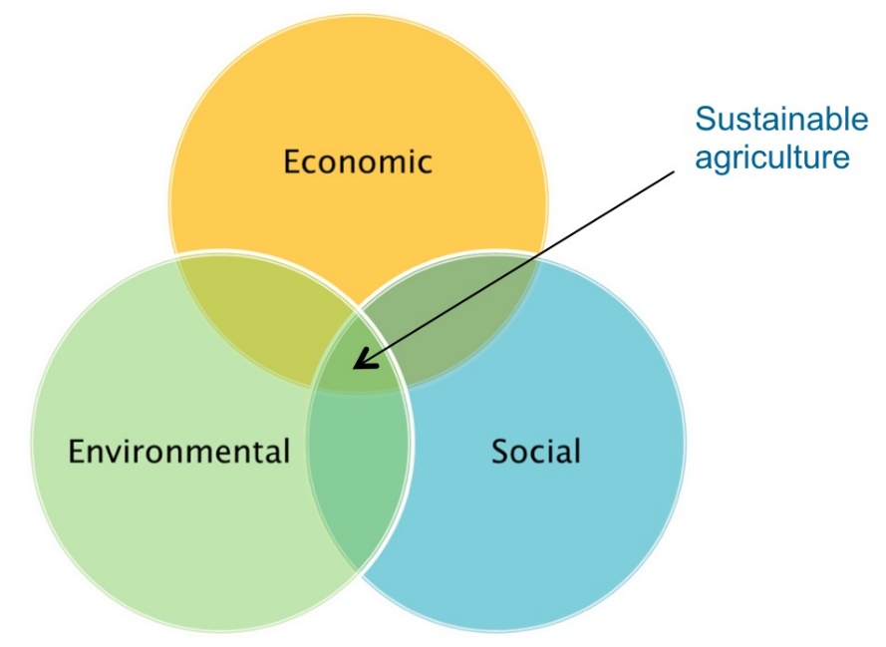
Future directions
Contribute to IPM strategies
Sustainable agricultural practices
National strain bank
Consortia for environments

Slide 29

Challenges in Communication
Public misperception of risks
Farmers acceptance
The GM and gene editing lessons
Product safety

Slide 30

Challenges in Commercialisation
Regulatory & Registration issues
Product definitions
Insufficient regulatory guidelines
Playing with the ‘big boys’
Breaking the chemical mould
acumenmd.com

Slide 31



From Concept to Commerce
A new campus company
2018

Slide 32






Acknowledgements
Trevor Hodkinson, TCD
Erika Soldi, TCD
Marta Jadwiszczak, TCD
Fiona Doohan, UCD
Bredagh Moran, UCD
Eoghan Curran, UCD

